Slide 1


PC Build Workshop
Creating a custom PC build and rating website to empower users. Developed by Manan Gola, Pranav Singh, Tushar, and Kumar Harsh.
B.Tech CSE Data Science

Slide 2


Introduction to the Platform
Custom PC Building
Compatibility Check
Users choose components tailored to their needs and preferences.
A system automatically validates component compatibility to prevent errors.
Build Rating
Users can rate and review their completed PC configurations.

Slide 3
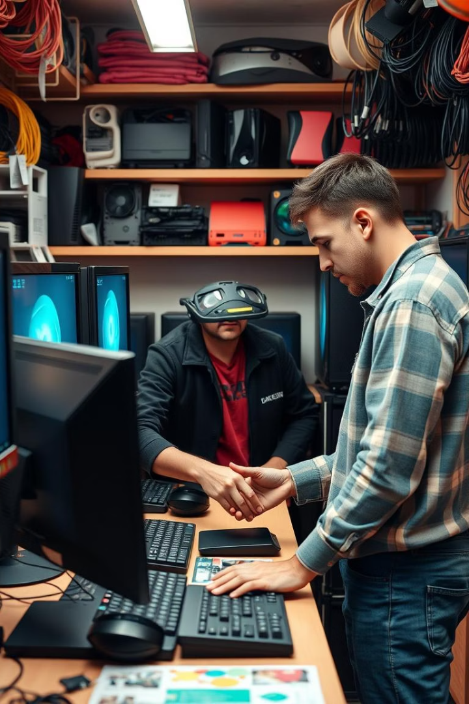
Problem Statement
Unclear Component Selection
Compatibility Confusion
Difficulty guiding customers through the complex choices of parts.
No simple way to ensure parts work together without errors.
Missing Build Ratings
Lack of a platform to assess and share user build feedback.

Slide 4
Project Objectives
Component Selection Website
Budget-Based Filtering
Build Ratings & Reviews
Develop a user-friendly platform for choosing PC parts.
Help users select parts that fit specific budget categories.
Allow users to rate and provide feedback on their builds.

Slide 5

Development Methodology
Frontend
HTML, CSS, JavaScript
Backend
Python with Flask/Django framework
Database
MySQL for storing components and ratings
Testing
Compatibility and user experience validation

Slide 6




Expected Outcomes
Website Functionality
User Reviews
1
2
Fully operational PC building and rating platform.
Active community sharing ratings and reviews of builds.
Interactive UI
Categorized Database
Fluid user interface with smooth navigation and feedback.
Component data organized for easy selection and filtering.
4
3

Slide 7
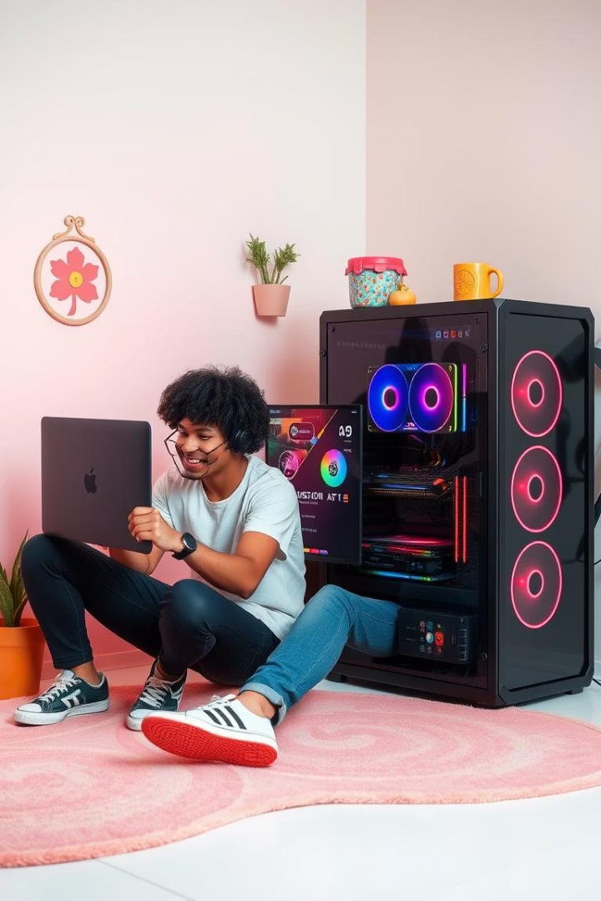



Applications of the Website
PC Enthusiasts
Online Stores
Gamers & Professionals
Find guidance and ideal compatibility in custom builds.
Integrate compatibility checkers to improve sales confidence.
Optimize hardware setups for gaming and work efficiency.

Slide 8

Challenges & Limitations
Component Database Updates
Compatibility Algorithms
Keeping the component list current with latest products.
Developing accurate checks for diverse hardware combinations.
User Adoption
Attracting users and motivating ongoing community engagement.

Slide 9





User Interaction Workflow
Select Budget
Choose Components
CPU, GPU, RAM, Storage, and more
Compatibility Check
Instant validation and error suggestions
Finalize Build
Rate & Review

Slide 10
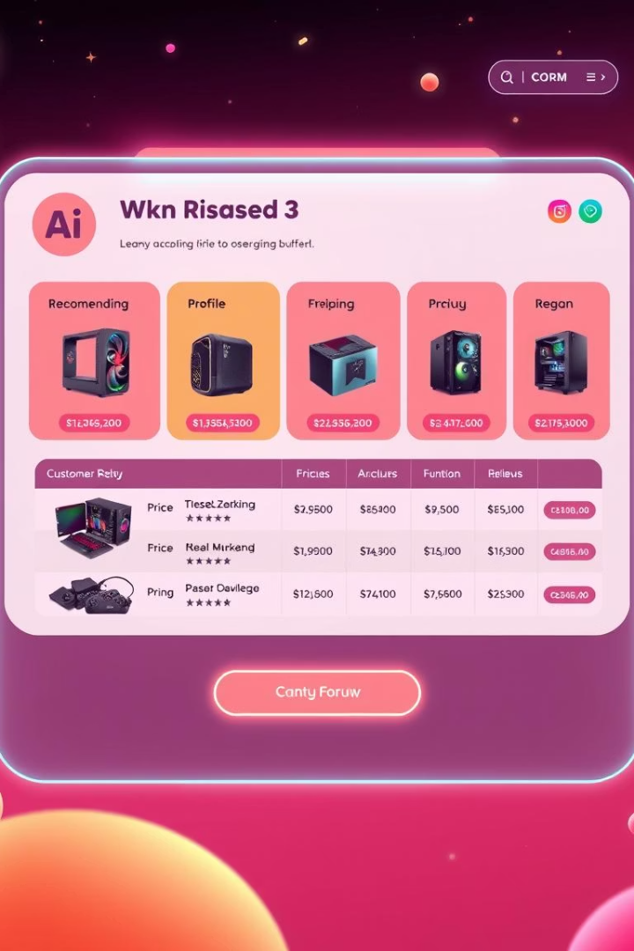
Future Enhancements
Price Comparison Integration
Connect with stores for real-time pricing data.
AI Recommendations
Use AI to suggest optimized build configurations.
Community Forum
Enable discussions and sharing among users.
Mobile Application
Offer easier access on phones and tablets.

Slide 11
Q&A
Any questions?
THANK YOU

